Slide 1
20th Century Social Changes in America
IB History

Slide 2
SECTION 1: POSTWAR AMERICA
After WWII, returning vets faced a severe housing shortage
In response to the crisis, developers used assembly-line methods to mass-produce houses
Developer William Levitt bragged that his company could build a home in 16 minutes for $7,000
Suburbs were born
With the help of the GI Bill, many veterans moved into suburbs

Slide 3
REDEFINING THE FAMILY
A return to traditional roles after the war was the norm
Men were expected to work, while women were expected to stay home and care for the children
Conflict emerged as many women wanted to stay in the workforce
Divorce rates surged

Slide 4
REMARKABLE ECONOMIC RECOVERY
Experts who predicted a postwar depression were proved wrong as they failed to consider the $135 billion in savings Americans had accumulated from defense work, service pay, and investments in war bonds
Americans were ready to buy consumer goods

Slide 5
SECTION 2: THE AMERICAN DREAM IN THE FIFTIES
After WWII ended, Americans turned their attention to their families and jobs
New businesses and technology created opportunities for many
By the end of the 1950s, Americans were enjoying the highest standard of living in the world
Ozzie and Harriet reflected the perfect American family

Slide 6
SOCIAL CONFORMITY
American workers found themselves becoming standardized
Called the “Organization Man,” the modern worker struggled with a loss of individualism
Businesses did not want creative thinkers, rebels or anyone that would “rock the boat”

Slide 7
THE SUBURBAN LIFESTYLE
Most Americans worked in cities, but fewer and fewer of them lived there
New highways and the affordability of cars and gasoline made commuting possible
Of the 13 million homes built in the 1950s, 85% were built in suburbs
For many, the suburbs were the American Dream
The American Dream complete with a white picket fence

Slide 8
THE BABY BOOM
During the late 1940s and through the early 1960s the birthrate in the U.S. soared
At its height in 1957, a baby was born in America every 7 seconds (over 4.3 million babies in ’57 alone)
Baby boomers represent the largest generation in the nation’s history

Slide 9
What are the official years of the Baby Boom Generation?
1946 - 1964 saw a marked increase in the number of births in North America.
How did the birthrate rise and fall during the baby boom years in the US?
1940 | 2,559,000 births per year
1946 | 3,311,000 births per year
1955 | 4,097,000 births per year
1957 | 4,300,000 births per year
1964 | 4,027,000 births per year
1974 | 3,160,000 births per year

Slide 10
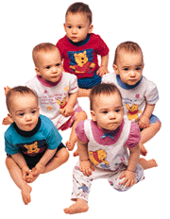
WHY SO MANY BABIES?
Why did the baby boom occur when it did?
Husbands returning from war
Decreasing marriage age
Desirability of large families
Confidence in economy
Advances in medicine

Slide 11
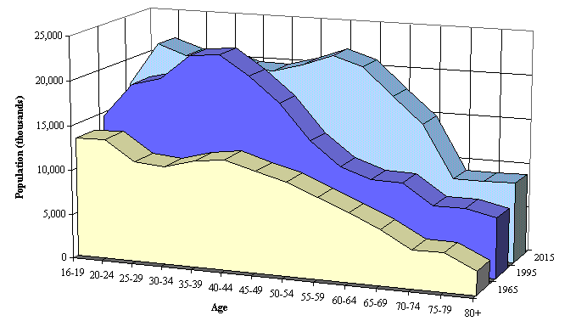
WHAT IT WILL MEAN TO YOU
Your generation will be supporting an increasingly aging American population

Slide 12
WOMEN’S ROLES IN THE 1950S
During the 1950s, the role of homemaker and mother was glorified in popular magazines, movies and television

Slide 13
WOMEN AT WORK
Those women who did work were finding job opportunities limited to fields such as nursing, teaching and office support
Women earned far less than man for comparable jobs

Slide 14
THE AUTOMOBILE CULTURE
After the rationing of WWII, inexpensive and plentiful fuel and easy credit led many to buy cars
By 1960, over 60 million Americans owned autos

Slide 15
INTERSTATE HIGHWAY ACT 1956
In 1956 Ike authorized a nationwide highway network – 41,000 miles of road linking America

Slide 16
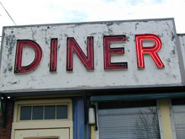
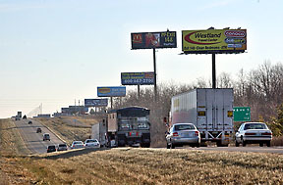
HIGHWAYS “HOMOGENIZE” AMERICA
Another effect of the highway system was that the scenery of America began to look the same
Restaurants, motels, highway billboards, gas stations, etc. all began to look similar
The nation had become “homogenized”
Anytown, USA

Slide 17
SECTION 3: POPULAR CULTURE
A new era of mass media led by television emerged in the 1950s
In 1948, only 9% of homes had T.V
In 1950, 55% of homes had T.V.
By 1960, 90% of American homes had T.V.

Slide 18
A SUBCULTURE EMERGES
Although mass media and television were wildly popular in the 1950s, dissenting voices emerged
The “Beat Movement” in literature and rock n’ roll clashed with tidy suburban views of life

Slide 19
BEATNIKS FOLLOW OWN PATH
Centered in San Francisco, L.A. and New York’s Greenwich Village, the Beat Movement expressed social nonconformity
Followers, called “beatniks”, tended to shun work and sought understanding through Zen Buddhism, music, and sometimes drugs
Beatniks often performed poetry or music in coffeehouses or bars

Slide 20
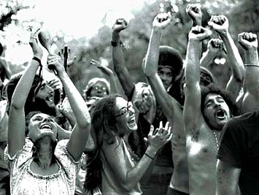
An Era of Social and Political Change

Slide 21
Kennedy’s New Frontier
Americans were struck by the youth and vitality of the Kennedy White House.
Kennedy’s public image was often different than reality.
Kennedy’s narrow victory in 1960 left him without the clear mandate he needed to work well with Congress.
The New Frontier came to be symbolized by the exploration of space.

Slide 22
The Supreme Court in the Early 1960s
During the Kennedy presidency, Supreme Court decisions made major changes in American society.
Under the leadership of Chief Justice Earl Warren, Court rulings extended individual rights and freedoms.
Voting-rights reform
The rights of the accused
Religious freedom

Slide 23
Chief Justice Earl Warren
Many historians regard Earl Warren as one of the most important chief justices.
Warren did not have a positive record on civil rights when President Eisenhower appointed him chief justice in 1953.
Called for the internment of Japanese Americans during World War II.
Fought against an effort to make California’s state Assembly more representative of the people.
However, as chief justice, Warren led the Court to one of the most significant civil rights advances in U.S. history.
Brown v. Board of Education banned racial segregation in the nation’s schools.

Slide 24
The Warren Court
Prior to legislation in the 1960s, states did not redraw the boundaries of legislative districts to reflect population changes.
Baker v. Carr (1962), Westberry v. Sanders (1964), and Reynolds v. Sims (1964) changed this practice to make each citizen’s vote more equal.
Voting-rights
Reform
Rights
of the
Accused
Mapp v. Ohio (1961), Gideon v. Wainwright (1963), Escobedo v. Illinois (1964), and Miranda v. Arizona (1966) extended the Bill of Rights to the actions of state governments.
In Engel v. Vitale (1962) and other cases, the Warren Court defined the religion guarantees of the First Amendment.
Religious
Freedom

Slide 25
Lyndon Johnson
Personality
Large and intense with none of Kennedy’s good looks, polish, or charm
Hardworking and ambitious
Genuine desire to help others
Greater concern for the poor and underprivileged than Kennedy
Believed in an expanded role for government in making Americans’ lives better
Political Experience
School teacher in Texas
Served as Texas Congressman
Served as U.S. Senator
Served as majority leader in the Senate after one term as senator
By 1960, Johnson had more influence in Washington, D.C., than any other Democrat.

Slide 26
Enacting Kennedy’s Agenda
War on Poverty
Kennedy was influenced by Michael Harrington’s The Other America, a study of poverty that shattered the popular belief that all Americans had prospered from postwar prosperity.
Johnson launched the War on Poverty when he asked Congress to pass the Economic Opportunity Act in 1964.
Economic Opportunity Act
Funded several new anti-poverty programs
The Job Corps offered work-training programs for unemployed youth.
VISTA was a domestic version of the Peace Corps.
Other programs provided education for adults, work for unemployed parents, and help to fight rural poverty and assist migrants.

Slide 27
The Great Society
In 1964 Johnson told the nation that he had his own plans for the United States. He called the domestic programs of his administration the Great Society.
In order to launch Johnson’s Great Society, he needed to win the 1964 election.
Chose Hubert Humphrey as his running mate
Republicans selected Barry Goldwater as their nominee.
Barry Goldwater’s views were very different from Johnson’s.
He suggested using nuclear weapons to end Vietnam.
Attacked the Great Society with claims that people were only equal in the eyes of God and that government programs to help people were similar to communism

Slide 28
Creating the Great Society
Elementary and Secondary Education Act - first large scale program of government aid to public schools
The Higher Education Act - created the first federal scholarships for needy college students
Head Start – education program for preschool children of low-income parents
Omnibus Housing Act – created Department of Housing and Urban Development (HUD)
Medicaid – program that provides free health care for poor people
Medicare – health care program for people over age 65
The Great Society emphasized the environment; laws were passed to improve water and air quality.
Lady Bird Johnson worked to preserve the outdoors and natural beauty of the United States.
Pushed for the Highway Beautification Act (came to be called Lady Bird’s bill)

Slide 29
Key Features of Nixon’s Politics and Domestic Policies
Nixon the Conservative
Believed the federal government was too large
Enacted “southern strategy” to appeal to former segregationists
Firm stand against crime and drug use
Nixon the Liberal
Increased funding for programs such as food stamps and increased Social Security payments
Took special interest in environmental issues
Created a new organization to prevent work-related injuries and deaths
Advanced affirmative action

Slide 30
Nixon’s Politics and Domestic Policies
New Federalism
Thought federal government was too large
Solution was called the New Federalism
Key feature was the concept of revenue sharing
Believed that local governments could spend taxpayers money more effectively
Southern Strategy
Nixon wanted to expand his support in the Democratic south
Tried to weaken the 1965 Voting Rights Act
Urged a slowdown in forced integration
Opposed busing
Wanted local governments to take action themselves
Drugs and Crime
Opposed federal court rulings that put limits on the power of the police.
Sought to name conservative judges to federal courts
Filled four openings on the Supreme Court (2 of his nominees were rejected)

Slide 31
Nixon’s Foreign Policies with China and the Soviet Union
Nixon had great success with his foreign policy issues.
Henry Kissinger was Nixon’s national security advisor and later secretary of state.
Kissinger shaped much of Nixon’s foreign policy.
Kissinger believed in the notion of realpolitik—or basing foreign policies on realistic views of national interest rather than on broad rules or principles.
Nixon took steps to ease tensions with Cold War enemies—a policy called détente.
The goal of détente was to build a more stable world in which the United States and its adversaries accepted one another’s place.

Slide 32
Nixon’s Foreign Policies
The Soviet Union
In 1969 Nixon began talks with the Soviet Union in order to slow the arms race.
Known as the Strategic Arms Limitations Talks (SALT)
Both nations had increased their number of weapons and made innovations in weapons technology (Ex. antiballistic missiles, or ABMs).
In 1972 Nixon and Leonid Brezhnev agreed to an ABM treaty.
Following this round of talks (now called SALT I), negotiations began on a second round of discussions.
China
Nixon wanted to improve relations with the Communist People’s Republic of China.
Believed that friendlier relations with China would force a more cooperative relationship with the Soviet Union (China’s rival).
His efforts were done secretly
Nixon surprised Americans by visiting China in 1972 where he met with Chinese leaders and Mao Zedong.
They agreed to disagree about Taiwan.

Slide 33
Trouble in the Middle East
1967 Six-Day War
resulted in Israel occupying territory that had belonged to the nations of Egypt, Syria, and Jordan
The United Nations passed a resolution that called for Israel to withdraw from these lands and for the Arab states to recognize Israel’s right to exist
1973 Yom Kippur War
Egypt and Syria attacked Israel, and the fighting affected the United States.
Threat of Soviet involvement could turn conflict into a superpower confrontation
Imposition of an oil embargo

Slide 34
Main events in the presidential election of 1972
Nixon was concerned about winning the 1972 presidential election and was not above using illegal actions to help ensure his re-election.
During his first term, Nixon advisors created a group that came to be known as the “Plumbers.”
Their job was to respond to “leaks” of secret information and to investigate Nixon’s political enemies.
In 1971 the Plumbers tried to damage the reputation of Daniel Ellsberg—the man who had leaked the Pentagon Papers—by breaking into Ellsberg’s psychiatrist’s office and looking for information on Ellsberg.
In early 1972 the Plumbers decided to break into the offices of the Democratic National Committee at the Watergate hotel to collect information about the Democratic strategy for the 1972 election.

Slide 35
Watergate
On June 17, 1972, police arrested five men who had broken into the offices of the Democratic National Committee.
Although the break-in barely made the news when it happened, it quickly became clear that the men had connections to the president.
Bob Woodward and Carl Bernstein of the Washington Post refused to let the story die and continued to investigate the break-in.
The Post reported that the break-in was part of a widespread spying effort by the Nixon campaign, but this did not seem to affect voters.
On election day Nixon won one of the most overwhelming victories in U.S. history.

Slide 36
Gerald Ford
Vice President Spiro T. Agnew resigned after being charged with cheating on his taxes and taking payments in return for political favors.
Nixon choose Gerald R. Ford to replace Agnew.
Ford was the Republican leader in the House of Representatives.
When Nixon resigned, Ford became president.
He was the first person ever to become president without having been elected either president or vice-president.

Slide 37
Carter Faces Domestic Challenges
Jimmy Carter came across as an honest man of deep religious faith who promised not to lie to the American people.
Carter immediately tried to help the nation heal some of the wounds of the past.
Ex. He issued a pardon to thousands of Vietnam War draft dodgers.
Carter tackled problems in the economy and with energy.
Finally, Carter tried to deal with environmental issues.

Slide 38
Challenges Facing the Nation
The Economy and Energy
Inflation and unemployment were high.
Carter made the development of a national energy policy a priority.
Wanted to ease dependence on foreign oil through energy conservation, developing new energy supplies, and loosening government regulation of the American oil industry
Asked Americans to conserve energy
Promoted the development of alternative energy sources
The Impact
The economy added many new jobs to help battle unemployment.
Carter was unable to bring down inflation, in fact, it got worse.
Carter’s energy policies were successful at helping reduce American dependence on foreign oil.
American production of energy increased under Carter.

Slide 39
Carter’s Foreign Policy
Carter came to office with little foreign-policy experience.
Carter promised that the concept of human rights would be at the forefront of his foreign policy.
Carter worked to strengthen ties between the United States and the Soviet Union and China.
Carter gave control of the Panama Canal back to Panama.
Carter helped Egypt and Israel deal with some of the divisions that caused conflicts between their countries.

Slide 40
Carter’s Foreign Policy
Panama Canal
American control of the Panama Canal had been a source of conflict between the two countries.
In 1977 Carter and Panama’s leader agreed that Panama would take control of the canal by the end of 1999.
The Senate narrowly approved the treaties.
For some Americans, loss of control of the canal represented a decline in American power.
Camp David Accords
Greatest foreign-policy achievement
Conflict between Egypt and Israel continued. Egypt would not recognize Israel and Israel continued to occupy Egyptian territory.
Carter guided Anwar el-Sadat and Menachem Begin to a historic agreement that came to be called the Camp David Accords.
Begin and Sadat won the Nobel Peace Prize in 1979.

Slide 41
A Crisis of Confidence
The Iranian Hostage situation dragged on throughout the presidential election year of 1980.
The situation in Iran also drove up gasoline prices so that prices of goods in the United States went up and inflation soared.
Many voters held Carter responsible for the problems and the downcast mood of the country.

Slide 42
Women Fight for Equality
In 1920 the 19th Amendment was passed giving women the right to vote (Women’s Suffrage)
In the 1960’s Feminism was the belief that women should have economic, political, and social equality with men
In 1963 Betty Friedan’s Feminine Mystique identified the “problem that has no name” Women were not happy in the 1950’s (Men’s work v Women’s work)
In the 1960’s women were forced into clerical work, retail, social work, nursing, and teaching

Slide 43
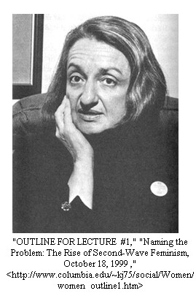

Slide 44
Women’s Activism of the 1960’s
Women were members of SNCC and SDS, and active in the civil rights movement
In 1966 28 women including Friedan founded the National Organization for Women (NOW)
NOW fought against gender bias in hiring and in the workplace and pushed for child-care facilities
In 1968 the New York Radical Women protested the Miss America Pageant in AC
“Women’s Garbage” into “Freedom’s Trashcan”

Slide 45
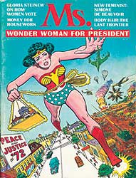
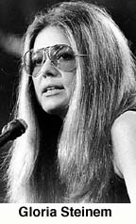
In 1969, a journalist and political activist Gloria Steinem joined the feminist movement
She founded the National Women’s Party Caucus
In 1972 she founded and wrote for Ms. (Women’s Magazine)

Slide 46
The Equal Rights Amendment (ERA)
Congress passed the ERA in 1972, it was first introduced in 1923 (Men and Women same rights and protections)
38 states needed to ratify it to make it part of the Constitution ( 35 received)
A Stop-ERA campaign was launched by conservative religious groups, and anti-feminists led by Phyllis Schlafly
Radical Feminist “hate men, marriage, and children”
Fears of women being drafted, no husband responsibility, and possible same-sex marriages

Slide 47
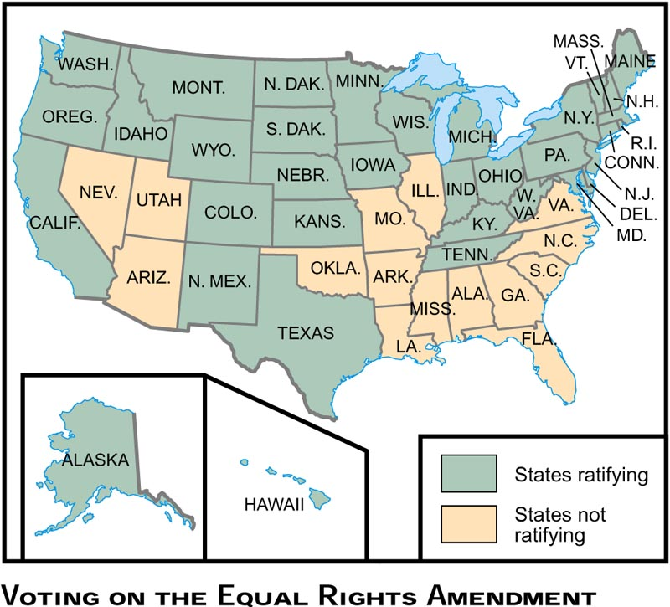

Slide 48
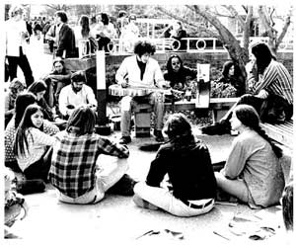
The Counterculture of the 1960’s
Counterculture was a movement made up of mostly white, middle-class college young people who were disillusioned with the war and injustices of society
They turned their backs on traditional American and founded a society based on peace and love
Hippies

Slide 49
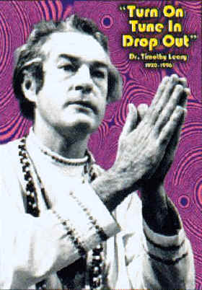
Materialism, Technology, and war were hollow
Harvard Psychology and counterculture philosopher Dr. Timothy Leary urged the youth to “Tune in, Turn On, Drop Out!”
Many left home, work, and school to create an ideal community of peace love and harmony

Slide 50
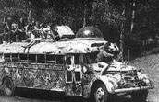
Hippie Culture
The Age of Aquarius
Rock ’n’ Roll Music
Sexual Revolution (Free Love)
Marijuana and LSD ( Illegal Drugs)
Eastern Religions (Zen Buddhism)
Ragged Jeans, Tie-dye shirts, military garments, love beads and muslin shirts
Long hair and beards
Many joined communes
Haight-Asbury District of SF

Slide 51
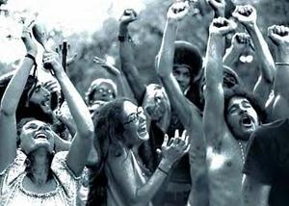
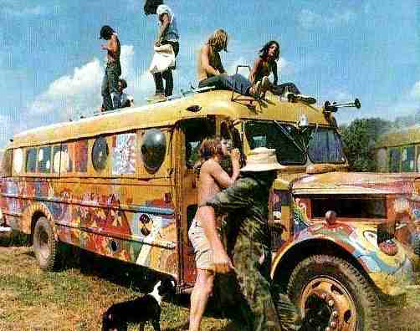
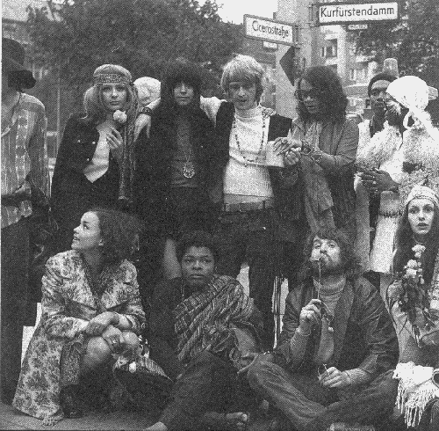
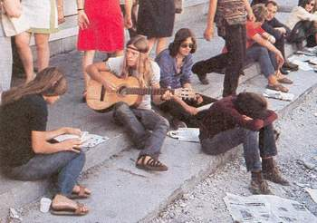

Slide 52
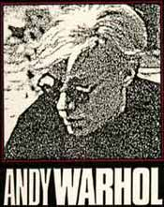
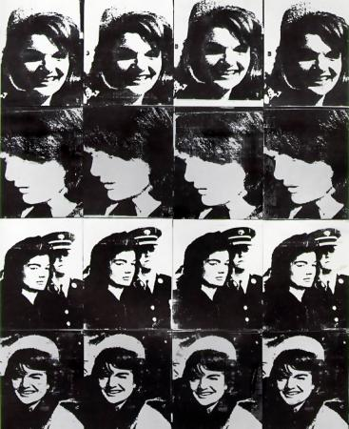
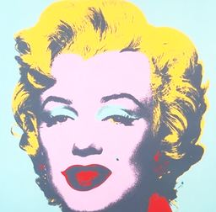
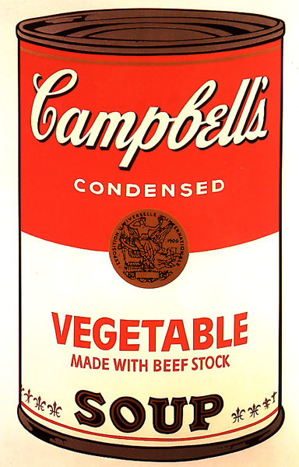
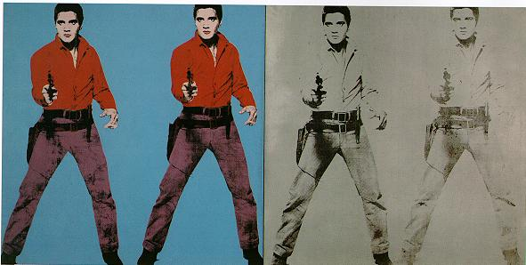
Art of the 1960’s
Pop-Art by Andy Warhol

Slide 53
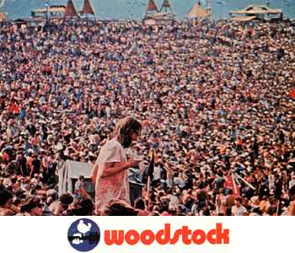

Slide 54
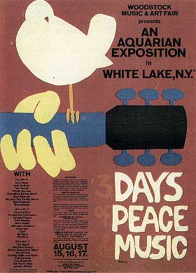

Slide 55
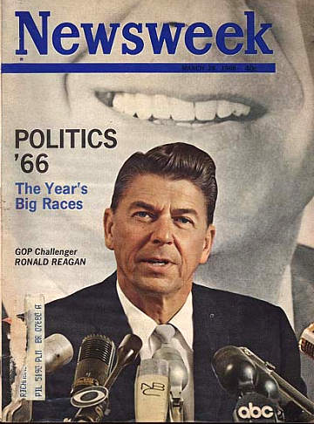
The New Right Emerges
In order to combat pro-choice and the ERA conservatives formed the “pro-family” movement which became the New Right (Social Conservatism when dealing with social, cultural, and moral problems)
They debated family centered issues and played key role in Pres. Reagan’s election in 1980

Slide 56
Reagan, Culture Wars, and Recent American History
1980-2004

Slide 57
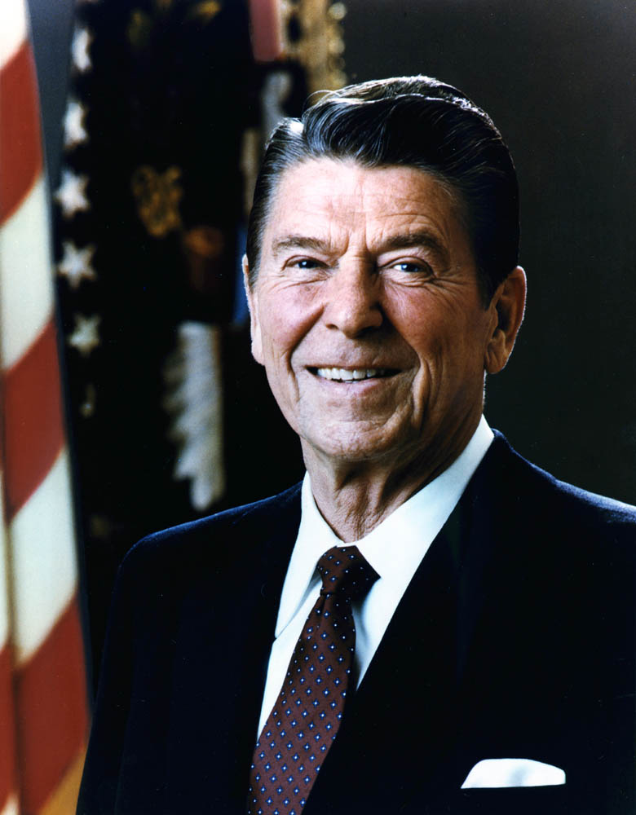
The Conservative Challenge (31)
Preview: “As frustration mounted over an era of limits, conservatives pressed to restore traditional religious and social values. Ronald Reagan led the political charge with a program to reduce government regulations, raise military spending, and lower taxes…. But as the national debt rose sharply and a recession deepened, voters reined in the conservative movement.”
The Highlights:
The Conservative Rebellion
Jimmy Carter: Restoring the Faith
Prime Time with Ronald Reagan
Standing Tall in a Chaotic World
An End to the Cold War

Slide 58
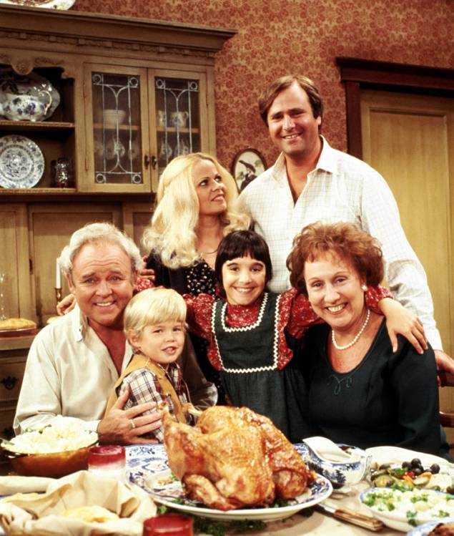
The Conservative Rebellion
The Media as Battleground
Topical sitcoms
M*A*S*H
People for the American Way: Norman Lear – more diversity
The Election of 1980
Ronald Reagan speaks the language of “true conservatism”
Reagan makes striking gains among union workers, southern white Protestants, Catholics, and Jews
All in the Family – Norman Lear creation

Slide 59
Conservative Backlash, 1965-1980
Conservatives react against changes in America during the 1960s
American foreign policy
“Lost Vietnam”
Affirmative Action
Women’s liberation

Slide 60
The Growing Backlash
1978: Regents of U.C. v. Bakke
“Quotas” in college admissions were unconst.
1976: Hyde Amendment
Limited Medicaid funds for Abortion
Moral Majority, 1978
Southern Democrats become Republicans
Many working class Anglos or “White Ethnics” in industrialized urban areas, and new suburbanites blamed immigrants and the poor for their condition, as well as economic decline of “Americans”

Slide 61
Conservative ideology
Ignored global changes in economy that led to the decline of American manufacturing and industrial base
“Tax and spend” Great Society & War on Poverty
Creationism, “family values,” cut government, stop communists, end abortion, no immigration
Strong military / national defense
American global power
Individualism
Lead to “Culture Wars” & Reagan “Revolution…”
Religious Fundamentalism

Slide 62
Conservative Groups & Leaders
Barry Goldwater, AZ
Orrin Hatch, UT
Strom Thurmond, MS
Ronald Reagan, CA
Jerry Falwell
Phyllis Schafly

Slide 63
Conservative Concerns
Conservative reactions to the “excesses” of the 1960s and 1970s
Lost control of America
Diversity =
Divorce, gay rights, abortion, day care, big government, & decline of the family
Stopped ERA
New “traditionalism”

Slide 64
American Malaise
Soft America and “decline” of American power
OPEC and Oil Embargo
Stagflation
De-Industrialization
Iranian Hostage Crisis (Nov. 1979)
Ayatollah Khomeini overthrew Shah of Iran
50 Hostages for over a year
Failed rescue effort
USSR invaded Afghanistan (Dec. 1979)

Slide 65
Ronald Reagan
CA. Governor Reagan
Anti-communist
“Black and white”
“New Day in America”
Charismatic
Channeled anger of mainstream white America at minorities, immigrants, feminists, taxes, affirmative action, big government

Slide 66
Reagan’s Conservative Vision
Vietnam was a “Noble Cause”
Renew the Cold War
American Power
Patriotism
Traditionalism
State’s Rights
“Individualism”
Feel Good

Slide 67
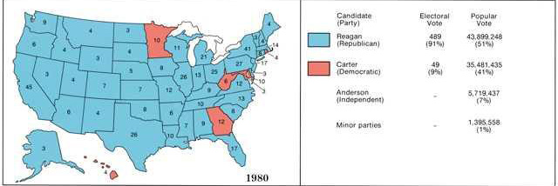
The Conservative Rebellion
The Election of 1980
Ronald Reagan speaks the language of “true conservatism”
Reagan makes striking gains among union workers, southern white Protestants, Catholics, and Jews

Slide 68
Reaganomics: “Trickle-Down”
DOD spending up 45%
$3 trillion debt, 1981-9
Rising # of Fortune 500 companies
Expansion of “working poor”
Decline in real wages
Household debt
Deregulation and Savings & Loan Crisis $500 b
Ketchup is a vegetable
Tax cuts boosted elite incomes
Privatization and deregulation

Slide 69
Iran-Contra Affair, 1980s
1979 election in Nicaragua
Sandinistas
U.S. opposed them
Sold military land & weapons to Iran (Khomeini), in return for release of hostages
Used weapons against Iraq
Gave $ to “Contras” who fought Sandinistas
Col. Oliver North
Illegal sale of US property w/o Congressional approval
Aid to Contras violated the Boland Amendments

Slide 70
US opposed Sandinistas in Nicaragua
Secret weapon sales to Iran
$ from weapon sales send to Contras
Contras fought war against Sandinistas
Destabilized both regions

Slide 71
Immigration
1964 law
8 million legally
1986 IRCA (Reagan Administration)
Legalization
Nominal fines
Southeast Asia & Latin America
Reasons
Economics
Obstacles
Culture wars, racism
INS/Border Patrol, Operation Hold the Line, Gatekeeper
Propositions against bi-lingual education and public schooling, health care for undocumented immigrants

Slide 72
Cycles of Anti-Immigrant Fear
1910s
1990s

Slide 73
International Events
End of the Cold War
Reagan: “Evil Empire”
Mikhail Gorbachev
Fall of the Berlin Wall
Collapse of USSR
Reagan took credit for the end of the Cold War

Slide 74
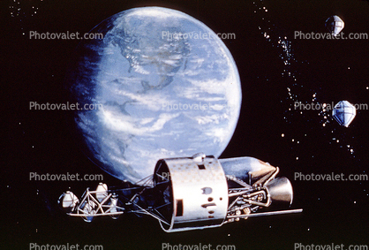
Prime Time with Ronald Reagan
The Military Buildup
Core of the Reagan revolution is sharp rise in military spending
Star Wars (Strategic Defense Initiative –SDI)
Star Wars Missile defense system proposal, SDI, Strategic Defense Initiative

Slide 75
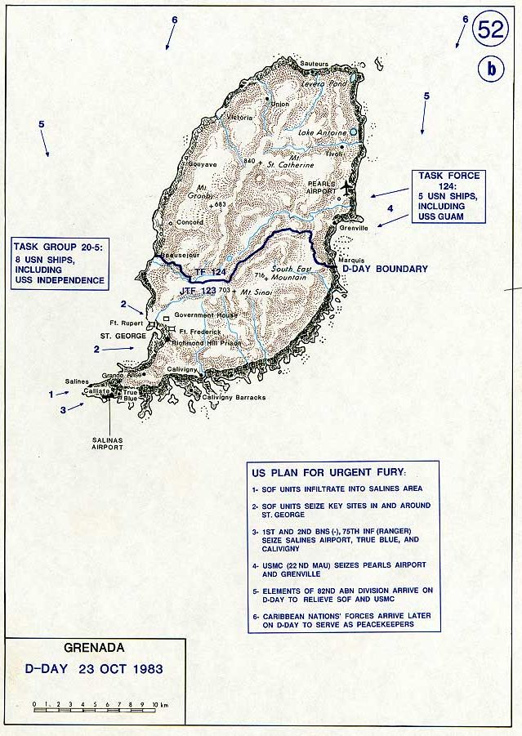
A Chaotic World
Terrorism in the Middle East
American Marines sent into Lebanon part of a European-American peacekeeping force
Terrorist attacks by Islamic fundamentalists bedevil Reagan
Mounting Frustrations in Central America
Grenada invasion (1983)
Boland Amendment

Slide 76
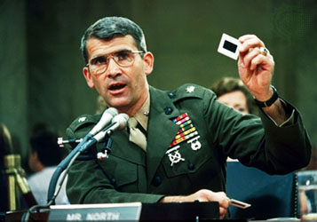
A Chaotic World
The Iran-Contra Connection
Arms for hostages deal
Lieutenant Colonel Oliver “Ollie” North
Cover Blown
“Irangate”
From Cold War to Glasnost
Mikhail Gorbachev
Intermediate Nuclear Force treaty (1987)

Slide 77
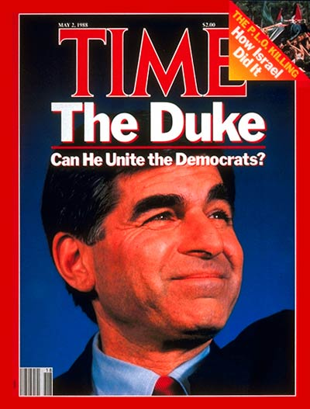
A Chaotic World
The Election of 1988
Vice-President George Bush versus Governor Michael Dukakis of Massachusetts
Bush wins with 54 percent of the popular vote

Slide 78
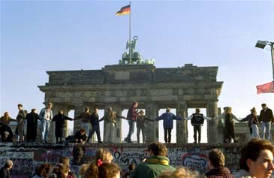
An End to the Cold War
A Post-Cold War Foreign Policy
The fall of communism
START Treaty

Slide 79
Bush I to Bush II: The 1990s
Post Cold War
Unclear foreign policy
Who is the enemy now?
Focused on domestic issues
Gulf War
NAFTA
New Democrats
Balanced Budget
Immigration
2000 Election

Slide 80
George I: 1988-1992
Connecticut Family
Director of CIA
VP to Reagan
Invasion of Panama
Iranian Revolution and Iran-Iraq War
Over 60% of global oil

Slide 81
Middle East
Persian Gulf War of 1991
Iraq invaded Kuwait
Sent 200,000 troops to Saudi Arabia (Desert Shield) warn Saddam Hussein
Increased troops to 430,000 and in February 1991 invaded Iraq to free Kuwait
Control of the media, “smart bombs”, and Colin Powell’s “overwhelming force” doctrine

Slide 82
A “New Democrat”: 1992-2000
Arkansas Gov.
Working class, single parent household
Charismatic
Opposed Vietnam War
New Democrat
Fiscally conservative
Socially moderate
Multilateralism

Slide 83
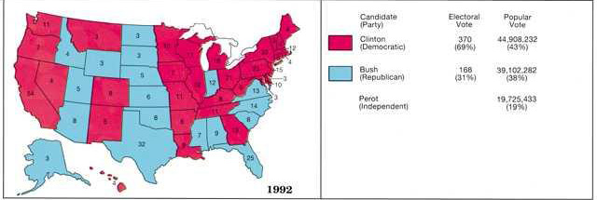
The Domestic Agenda
The Election of 1992 – Clinton, Bush, Perot
Gramm-Rudman Act (1985)
White-collar unemployment
“It’s the economy…”
Unresolved Conservative Revolution

Slide 84
Main Issues and Events
Tried to allow gays and lesbians to openly serve in the military
Failed. Cultural conservatives and military leaders opposed it. “Don’t ask, don’t tell.”
Tried to reform health care system to benefit the poor and uninsured.
Failed. Pharmaceutical industry, doctors, republicans opposed it.
Balance the Budget.
Succeeded. Returned taxes on the rich back to previous levels. Cut spending. Increased tax credit for low income families

Slide 85
Early 1990s
Post-Cold War era
No communist “menace”
Base closures
Economic growth
Wealth discrepancies, “knowledge economy”
Demise of Unions
Deep political divisions
Ongoing “Culture Wars”
Global Warming and environmental pollution
Consumer Debt

Slide 86
“Contract with America”
1994 Congressional Elections
Newt Gingrich
Speaker of the House
Welfare “Reform”
Balanced Budget
More prisons & harder sentences
Defense spending
End abortion
39% voted

Slide 87
Continued…
Bill and Monica
Cover-up
House: Articles of Impeachment
Senate: No
1993: North American Free Trade Agreement
1994: General Agreement on Tariffs and Trade
1995: Oklahoma City and Timothy McVeigh

Slide 88
The 2000 Election
Most bitterly contested election in 100 years
Gore/Lieberman
Moderate populism
Shadow of Clinton
Bush/Cheney
“Compassionate Conservative”
Roughly ½ of eligible voters went to polls
Voting irregularities
Florida

Slide 89
Bush II
Reversal of Clinton’s policies
$1.3 Trillion tax cut
Economic recession ?
Globalization and Y2K
Rolled back environmental protection and regulations
2000 census
Immigration, borders and cheap labor

Slide 90
US & Globalization
The very same capitalist system promoted by the US, exported globally, brought changes to the US
Immigration to US fueled by globalization and movement of capital, search for cheap labor
Global capital left the US, wages declined, cheap goods imported, produced by lower wage workers
Attack on unions, benefits, entitlements
“Wal-Mart economy”
Small population, massive resource use & pollution
2000 Mexico was second largest trading partner
Cultural intermixture vs. fear and reaction

Slide 91
Invasion of Iraq, 2003--2010
Bush administration tied 9/11 attacks, Bin Laden and Al Qaeda to Iraq and Saddam Hussein
Global terrorist threat and “Axis of Evil”
Remake the Middle East into pro-Western democracies favorable to the US
War dragged on…
Several trillion dollars

Slide 92
Election of Barak Obama
Constitutional Lawyer, Harvard Law Review
Bi-racial
Moderate/liberal
Economic crisis
Health Care
National debt
Crippled GOP

