Slide 1
Boom and Bust “A return to normalcy” The Roaring 20’s The Jazz Age The Good Times

Slide 2
Impact
Progressivism
Imperialism / Expansionism
WWI

Slide 3
A New Era
In 1920, Warren G Harding is elected president
States the nation needed a “return to normalcy”
However, the 1920’s will be a period of great innovation and change in American society and culture

Slide 4
New Technology
King of The Road
The Automobile - Henry Ford was the first to successfully produce and market the automobile
1907, Ford sold 30,000 Model T
His vision for mass production set him apart
Ford saw his employees as “consumers” – he will increase their wage to $5 a day
1907 – 1926, Ford built half the automobiles in the world (16, 750, 000)
Social Impact – changed the auto from a toy for the wealthy to an affordable necessity; created new business opportunities; eased the isolation of rural life; allowed people to live farther away; the auto commuter

Slide 5
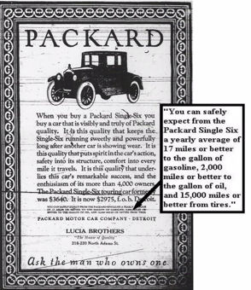
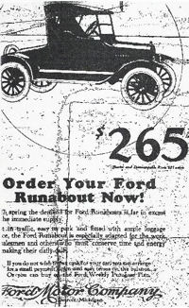
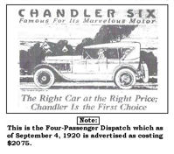

Slide 6
New Technology
A New Industry
In 1903 , at kitty hawk, NC, the Wright Brothers (Orville and Wilbur) conduct the first successful flight
Quickly planes are used for military and mail purposes
1926 came the airline industry and commercial air travel
In 1927, Charles Lindbergh flight across the Atlantic will boost airline travel
By the end of 1928, 48 airlines were serving 355 cities
Amelia Earhart set out to fly around in 1937; she made 2/3 of the trip before disappearing
Bessie Coleman was the first African American female to obtain her pilots license (her first air show was in 1922)

Slide 7
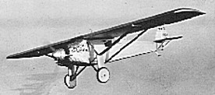
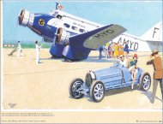
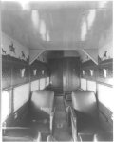
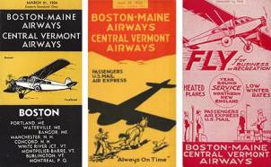

Slide 8
A Transformed Home
The increased availability of electricity in homes
New appliances were the latest rage
Refrigerators meant less spoiled food
Sewing machines, vacuum cleaners, and washing machines will reduce chore time
People found themselves with more leisure time
A new development of nightlife – shows, dinner
A new mass media formed – national magazines
Radio became an important means of communication and entertainment
1910-1930, a boom in the movie industry – from silent movies to movies with sound (“talkies”)
Fashions and lifestyle portrayed in movies will help define the American lifestyle

Slide 9
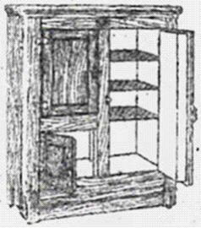
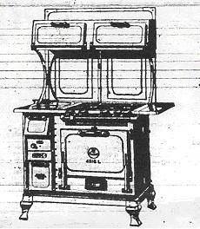
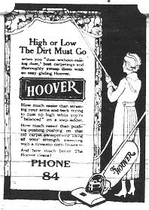
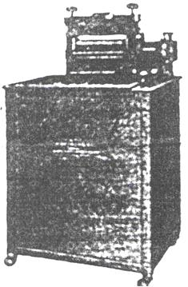

Slide 10
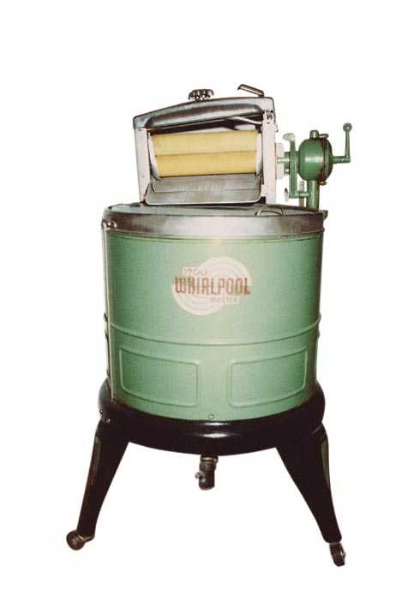
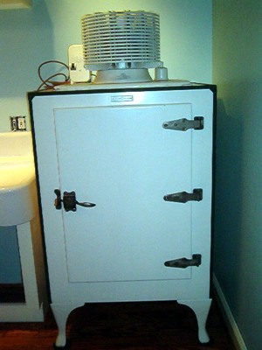
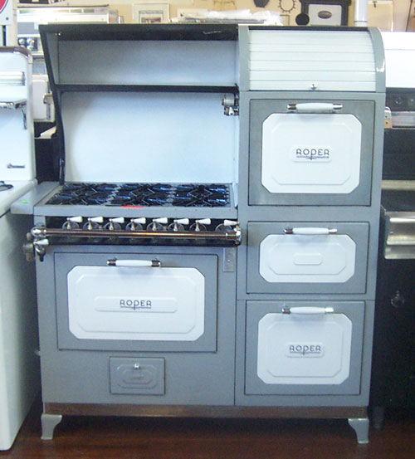
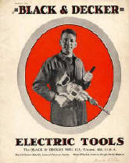
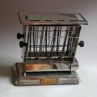
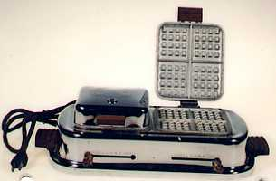
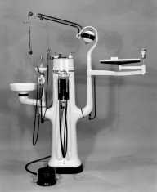
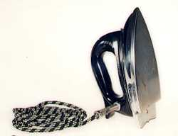
Consumer Economy

Slide 11
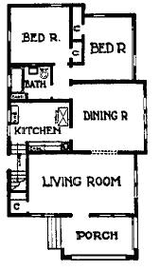
1924 Milwaukee Wisconsin Seven Room Home w/ light water and gas (Large Lot) $4,000
1924 Syracuse New York Lower two Bedroom Flat for Rent $40.00 per month
1920 Green Bay Wisconsin Four-room Bungalow w/one acre land $3,100

Slide 12
What Else Can I Buy?
Aerosol Sprays ----- 1926 Norway by Erik Rotheim
Frozen Food ----- 1924 USA by Clarence Birdseye
Hair Dryer ----- 1920 Germany
Quartz Timekeeping ----- 1927 Switzerland
Sticky Plasters ----- 1920 USA by Earle Dickson

Slide 13
Hey What About Me? I’m Just A Kid!
the Raggedy Ann Doll
Crayola Crayons
Die cast metal toys / airplanes and cars for young boys
Madame Alexander dolls in 1929
Yo-yo, also introduced in 1929
3-D view master as the biggest toy of the decade
Golden Age of Comic Books exploded in 1938 with the introduction of Action Comics and Superman
1930s though with board games. Monopoly, Sorry, and Scrabble were all invented in the 1930s

Slide 14
Consumerism
Innovative techniques and mass production meant more people could afford consumer goods
Advertisers will convince people they need these products
The “installment plan” will transform the consumer market
People were able to buy product s much sooner
The US became a “consumer society”
Initially was good for economic growth, it increased the debt

Slide 15
I Am Woman!
1920, 19th amendment gives the right to vote
Role and expectation of women changed drastically
Single women were usually hired
Fashion began to change
Behavior changed
Women began to go out on dates
This new women, “flapper”, tended to be more rebellious and fun loving
They will challenge the traditional gender role

Slide 16
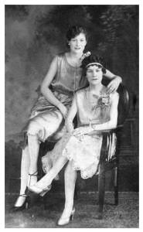
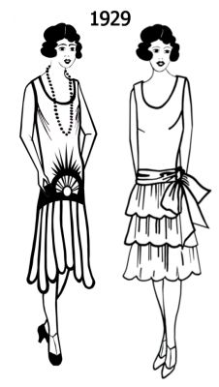

Slide 17
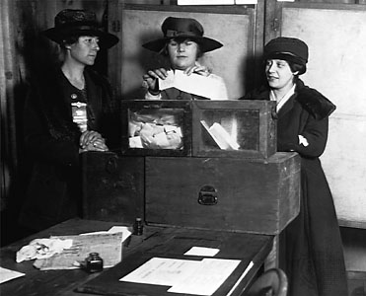
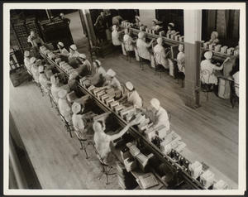
1920's also brought about great changes for women...
1920 - 19th Amendment gave them the federal vote
after 1920, social circumstances changed too as more women worked outside the home
and more women went to college and clamoured to join the professions
women didn't want to sacrifice wartime gains - amounted to a social revolt
characterized by the FLAPPER/ "new woman"
(bobbed hair, short dresses, smoked in public...)

Slide 18
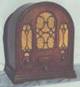
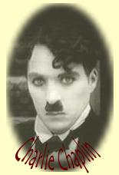
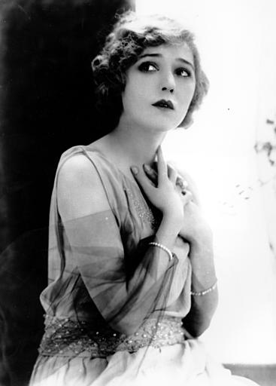
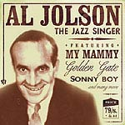
Culture of the Roaring 20’s
Radio
KDKA Pittsburgh
GE, Westinghouse,& RCA form NBC
Silent Movies
Charlie Chaplin
“Talkies”
The Jazz Singer
Starring Al Jolson
Mary Pickford
“America’s Sweetheart”

Slide 19
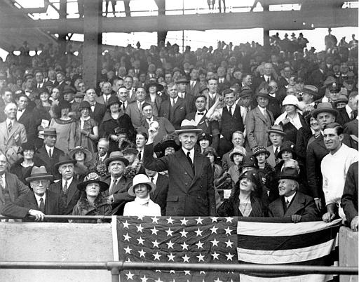
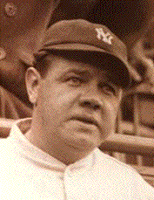
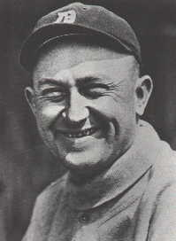
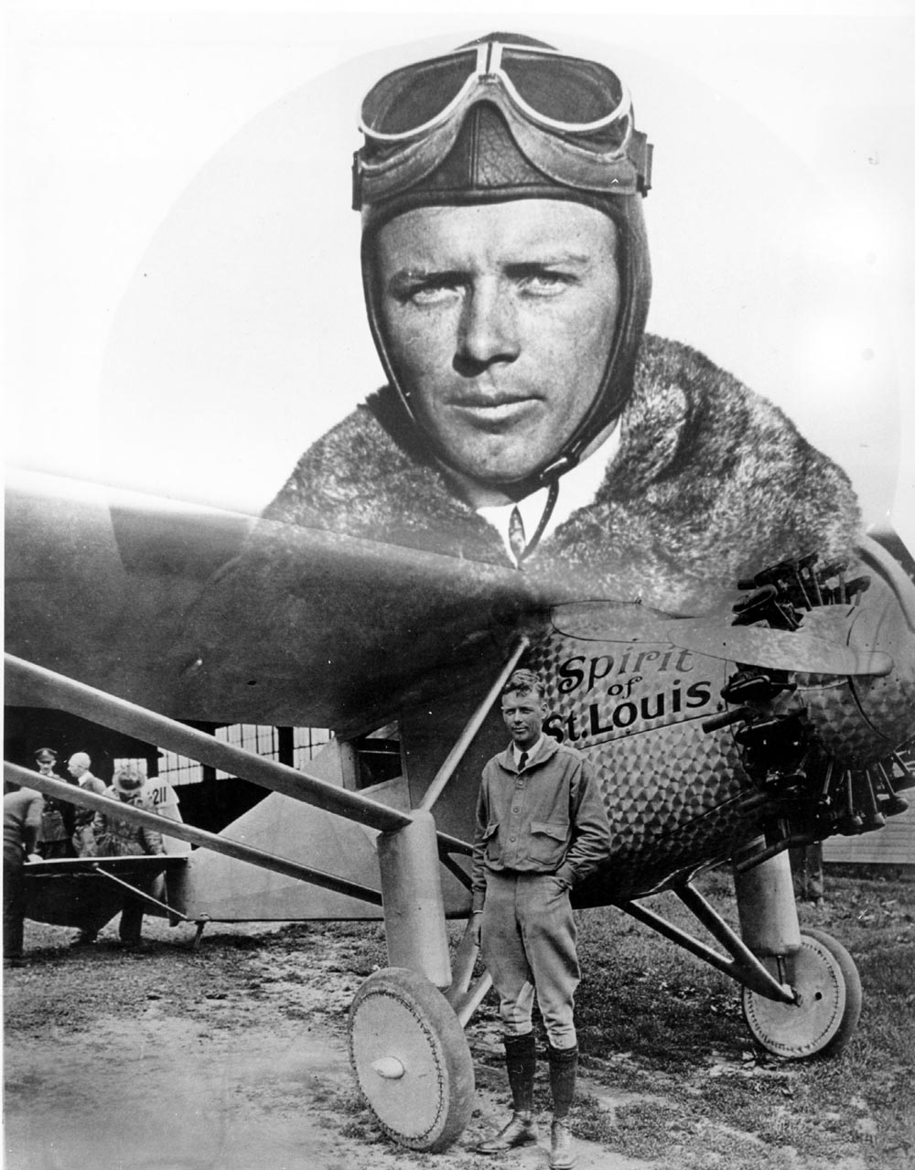
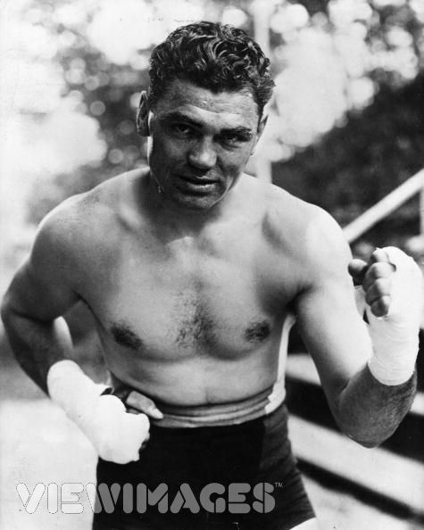
Celebrities
Babe Ruth &Ty Cobb
Charles Lindbergh
The Spirit of St. Louis
Jack Dempsey

Slide 20
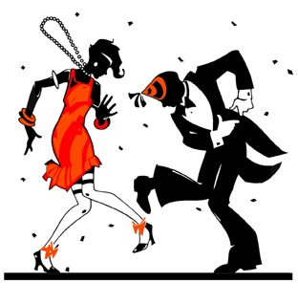
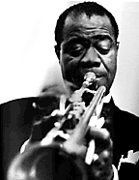
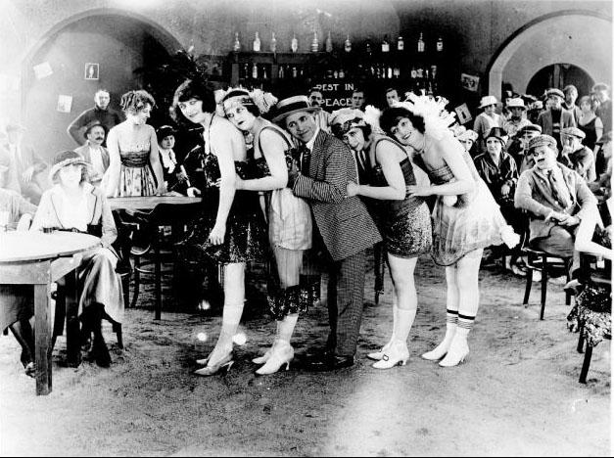
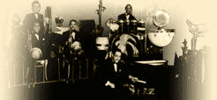
The 20’s is The Jazz Age
The Flappers
make up
cigarettes
short skirts
Writers
F. Scott Fitzgerald
Ernest Hemingway
Musicians
Louis Armstrong
Duke Ellington

Slide 21
New Scientific Discoveries
Began to examine and question traditionally held beliefs
The ideas of “evolution” will challenge “creationism”
Albert Einstein published theory of relativiety
He suggested that space, time, and mass were not absolutes; were relative to other factors
People began to question concepts like “personal responsibility”, moral “rights and wrongs” , and what is civilized vs. uncivilized

Slide 22
Intellectual Responses
Despite the prosperity, some were concerned with what they saw
Sinclair Lewis, critique society through stories like Main Street, Babbit, and Elmer Gantry; first US citizen to win Nobel Prize for literature
“Lost Generation” a group of writers that felt lost in society of greed and moral corruption: Scott Fitzgerald (The Great Gatsby) and Ernest Hemingway (The Sun Also Rises)

Slide 23
Categorize “Social Conflict and a Cultural Response
Initial reaction to culture changes were accepted, however, as the decade evolved, many people began to oppose the changes that were seen as un-American
Red Scare – reaction to Bolshevik Rev.; removed the czar and instituted communism; many in the US will be alarmed; anarchists attempted to assassinate Attorney General Mitchell Palmer and John D Rockefeller , many associated the attacks w / communism; Palmer will authorize the “Palmer Raids” many suspected as “subversives”; more than 500 immigrants were deporterd

Slide 24
Sacco-Vanzetti
Associating immigrants with communism led to one of the most controversial trials in US history
1920, two Italian immigrants were accused of murder; Massachusetts ; accused of being anarchists
Nicola Sacco and Bartolomeo Vanzetti
Evidence was disputable, but they were convicted
Executed in 1927

Slide 25
Sacco & Vanzetti Trial
-Italian Immigrants & Anarchists
-Convicted of Murder w/out Much Evidence
-Reflects both Nativism & Anti-Radicalism
-Controversial Execution
Sacco & Vanzetti

Slide 26
Cultural Reaction
Restrictions: a new rise to nativism after WWI; begin to place quotas on the number of immigrants allowed from countries (1924)
Most laws allowed more immigration from W Europe
Few laws addressed the W Hemisphere; as a result a large number of Catholic Hispanics immigrated
Resurgence of the KKK – fear of communism and mistrust of immigrants; while growing in numbers began to attack Catholics, Jews, and immigrants : tactics will include burning crosses, hate letters, pressuring employers; will turn to violence, lynching

Slide 27
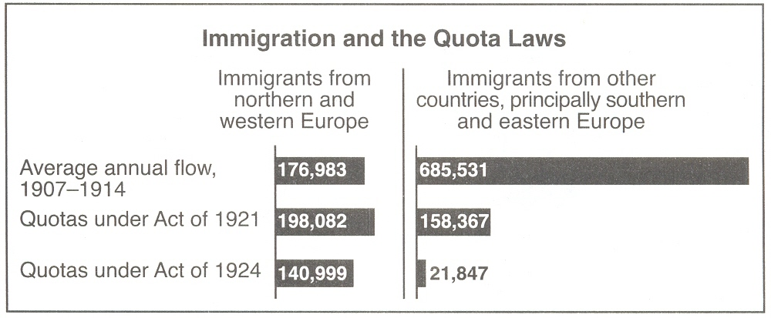
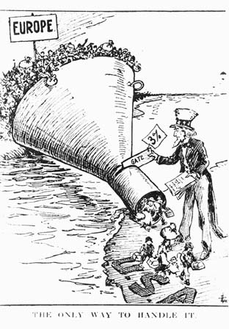
Nativism
Nativism: Anti-immigrant feeling
Quota Acts (National Origins Act)… set strict limits on immigration, especially from Eastern & Southern Europe
Based on scientific racism
Reflected growing nativist & anti-radical sentiment by groups like the KKK

Slide 28
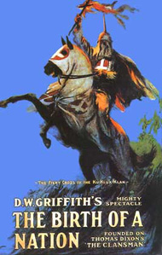
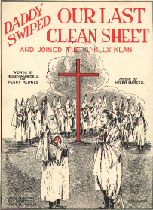
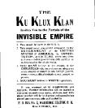
The Ku Klux Klan
Great increase
In power
Anti-black
Anti-immigrant
Anti-Semitic
Anti-Catholic
Anti-women’s suffrage
Anti-bootleggers

Slide 29
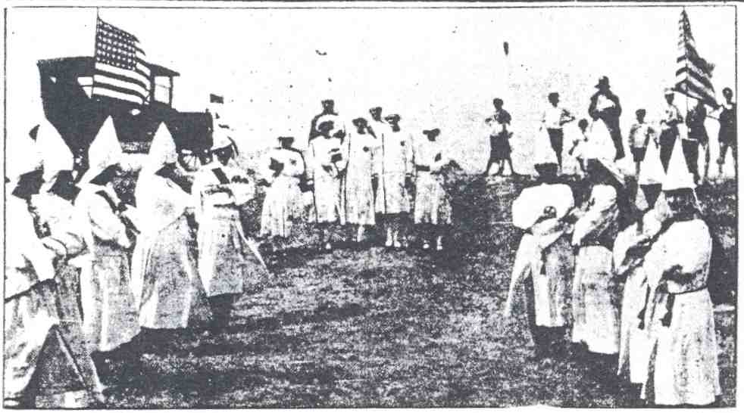
Klan Rally at Stow Flats Fairgrounds
July, 1924

Slide 30
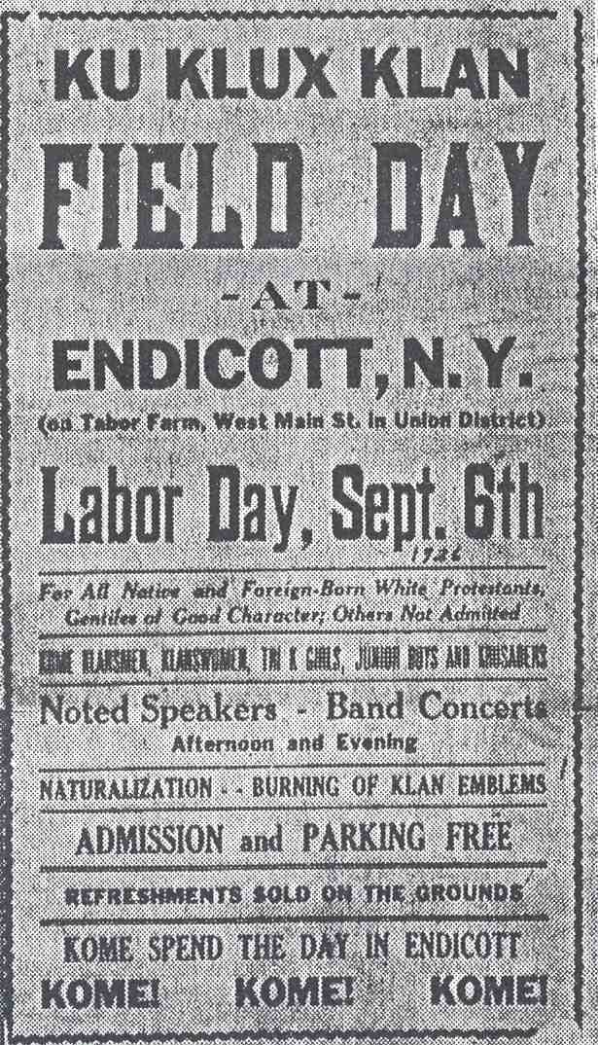
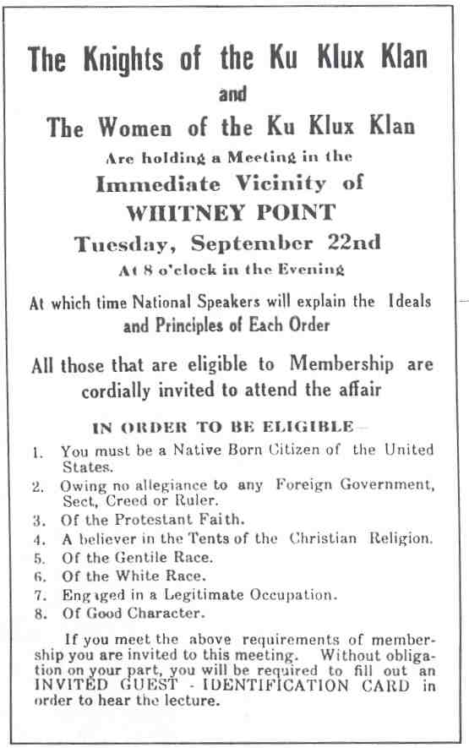
Local Klan Meetings

Slide 31
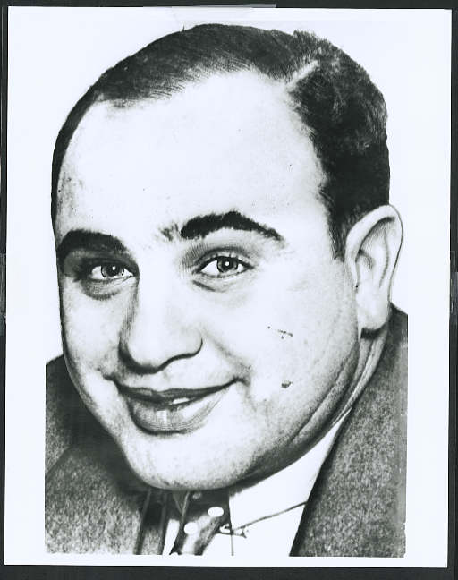
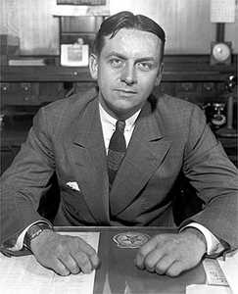
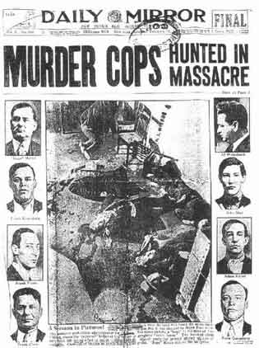
Prohibition
18th Amendment
Volstead Act
Gangsters
untouchables
Al Capone

Slide 32
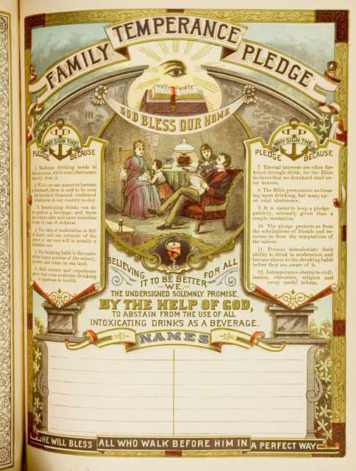
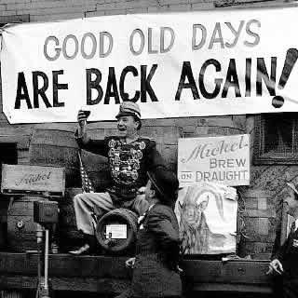
PROHIBITION - on manuf. and sale of alcohol
adopted in 1919 - 18th AMENDMENT
an outgrowth of the longtime temperance movement
in WWI, temperance became a patriotic mvmt. - drunkenness caused low productivity & inefficiency, and alcohol needed to treat the wounded
a difficult law to enforce... organized crime, speakeasies, bootleggers were on the rise
Al Capone virtually controlled Chicago in this period - capitalism at its zenith…
Prohibition finally ended in 1933 w/ the 21st Amendment
forced organized crime to pursue other interests…

Slide 33
Cultural Reaction
Prohibition – 1919, states ratified 18th amendment outlawing alcoholic beverages; Congress passed the “Volstead Act” to define intoxicating and enforced the amendment
The ban was known as “prohibition” and gave rise to the “bootlegger”
“Speakeasies” – illegal bars
Organized crime will grow; Al Capone, will use violence, intimidation, and bribing to dominate bootlegging and control public officials
Prohibition was a failure; 21st amendment will end in 1933

Slide 34
What Do You Think You Are Teaching?
Fundamentalism will grow in the 1920’s
Conflict between scientific theory and fundamentalism
Scopes Trial (Monkey Trial) – (1925) science teacher John Scopes was arrested for violating Tennessee law banning the teaching of Darwin’s theory
William Jennings Bryan volunteered to prosecute Scopes; Clarence Darrow will defend Scopes
Trial reached a climax when Darrow put Bryan on the stand
Scopes was found guilty; the law remained in effect

Slide 35
The Scopes “Monkey” Trial
-High School teacher John Scopes is tried for teaching evolution in Tennessee
-Became a debate on evolution & religious fundamentalism
-First major trial to reach a mass audience as it was broadcast live on the radio
Clarence Darrow & William Jennings Bryan

Slide 36
Historical Context: The Twenties
What comes to mind when you think about the 1920s?
Changing Gender Roles
New Styles & Behaviors
Rapid Economic Expansion
Cultural Renaissance
Political Corruption
The “Roaring Twenties”

Slide 37
Presidents of Prosperity

Slide 38
Harding Administration
A Return to Normalcy:
Part of the Ohio political machine
After serving one term as senator, ran for president
Created an open and easy going atmosphere
Brought in members of the Ohio Gang
“the air would heavy with tobacco smoke, trays with bottles of every imaginable brand of whiskey … cards and poker chips - a general atmosphere of waistcoat unbuttoned, feet on the desk, and spittoons alongside”
Many sold political jobs, contracts that made them money; several scandals broke out
Harding said he had no problems w/enemies, but with his friends
“they’re the ones that keep me walking the floors at night”

Slide 39
Harding Administration
Teapot Dome Scandal:
Sec of Interior, Albert Fall – secretly allowed private interests to lease land containing US oil reserves at Teapot Dome, Wyoming
In return, Fall received more than $300,000
The Senate investigated; Fall became the first member of the cabinet to go to prison

Slide 40
President Coolidge “The business of America is business.”
Fordney-McCumber Tariff
Smoot-Hawley Tariff
No help for farmers
Foreign Policy

Slide 41
Republican Power
President Harding
Elected 1920
Legacy of Scandals
“Teapot Dome”
Died in office

Slide 42
Coolidge Administration
Rose to national prominence while governor of Massachusetts
Served as Harding’s VP
He will quickly distance himself from Harding
Believed that prosperity rested on business leadership ; as president he was to make sure that govt. interfered as little as possible
“our troubles in this life would disappear if we would only sit down and keep still”
Election of 1924 – dems were deeply divided; they chose John Davis; republicans campaigned on “Keep Cool With Coolidge” and urges them to stay w/ the party that favored business; Coolidge won easily with 382 electoral votes
By avoiding war, reform, and scandal, Coolidge promised to give the US the normalcy Harding had failed to deliver

Slide 43
Hoover’s Administration
Coolidge decided not run for reelection
Election of 1928 – dems chose Alfred Smith; reps chose Hoover; prohibition was a key issue, religious differences, the prosperity of the 1920’s; republican slogan was “two cars in every garage”
March 4, 1929, Hoover was inaugurated; sound movie cameras covered the event for the first time and his speech was broadcast over the radio
He stated “I have no fears for the future of this country ….. It is bright with hope”

Slide 44
Temperance &
Prohibition
Religious Revival
Racial Violence
1920s
Cultural Conflict
Red Scare
Ku Klux Klan
Nativism

